Slide 1


Towards ending the AIDS Epidemic: Progress and Evidence
Willard Tinago, PhD
HIV Molecular Research Group
UCD School of Medicine
UCD School of Medicine

Slide 2

3.3 By 2030, end the epidemics of AIDS, tuberculosis, malaria and neglected tropical diseases and combat hepatitis, water-borne diseases and other communicable diseases

Slide 3
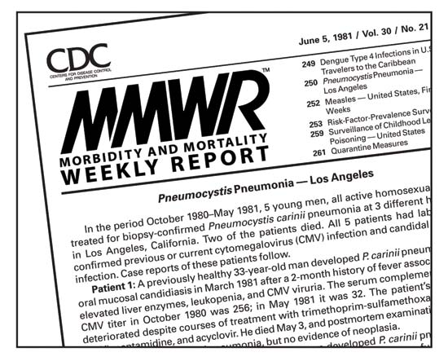
A new disease…
By the end of 1981, there was a cumulative total of 270 reported cases of severe immune deficiency among gay men, and 121 of those individuals had died
In 1983, Luc Montagnier and Françoise Barré-Sinoussi reported the discovery of a new virus (later called HIV) that is the cause of AIDS
The first commercial blood test for HIV was licensed in 1985, allowing screening for HIV
In 1987 the first anti-HIV drug (AZT) was approved by the U.S. Food and Drug Administration.
The first potent combination of anti-HIV drugs became available in 1995.

Slide 4
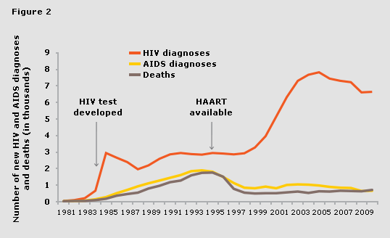
Declining morbidity & mortality
Potent combination of anti-HIV drugs
First anti-HIV drug (AZT)
AZT recommended for use in PMTCT
Annual new HIV and AIDS diagnoses and AIDS related deaths in the U.K. from 1981 to 2010. Source: HPA2

Slide 5
Antiretroviral therapy as prevention….
Does treatment of the HIV+ person prevent onward HIV transmission?

Slide 6





Myron S. Cohen, MD
Protocol Chair
6th IAS Conference, Rome, Italy
July 18, 2011
HPTN 052

Slide 7
HPTN 052 Study Design
Stable, healthy, serodiscordant couples, sexually active
CD4 count: 350 to 550 cells/mm³
Randomization
Immediate ART
CD4 350-550
Delayed ART
CD4 <250
Primary Transmission Endpoint
Genetically-linked transmission events
Primary Clinical Endpoint
WHO stage 4 clinical events, pulmonary tuberculosis, severe bacterial infection and/or death
Notes:
7
HPTN 052 enrolled serodiscordant couples and the infected participant required CD4 counts between 350 and 550. Infected participants were either offered immediate combination ART, or ART was delayed until CD4 fell between 20 and 250, but as close to 250 as possible. Two points to be made: when the study was designed WHO guidelines recommended that ART be initiated before CD4 fell below 200. Second, discordant couples are special and even a little unusual, because HIV transmission has not occurred. The primary endpoint of this study was measurement of linke transmission of HIV. We also messured clinical events and death as a stand alone endpoint, and as part of a composite endpoint that considered prevention and treatment benefits concomitantly. The composite endpoint served as a pre-arranged intervention boundary for the DSMB.

Slide 8
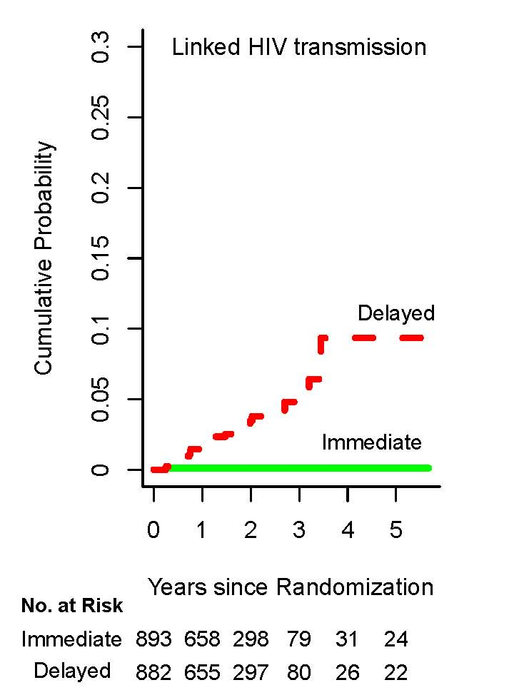
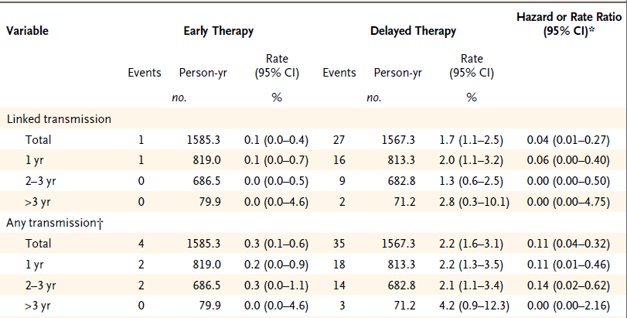
HPTN052: HIV-1 Transmissions
96% relative reduction in linked HIV transmissions
Cohen MS et al. NEJM 2011;365(6):493-505
Notes:
Transmission events in thedelayed arm were distributed across all the years of he study.
8

Slide 9
Antiretroviral therapy as prevention….
Does treatment of the HIV+ person prevent onward HIV transmission?
If ART prevents transmission are condoms still needed?

Slide 10
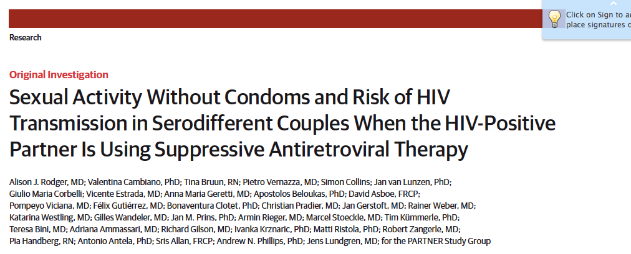
How effective is ART in HIV prevention?
1166 enrolled couples, 61.7% heterosexual, 38.3% MSM
‘…no documented cases of within-couple HIV transmission’
Rodger AJ et al. JAMA 2016;316(2):171-181

Slide 11
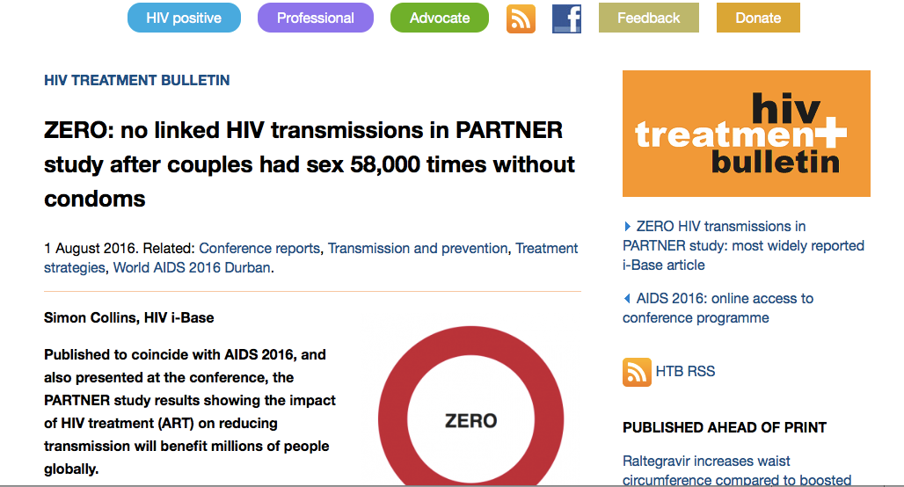
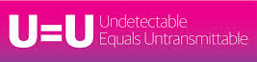
How effective is ART in HIV prevention?
‘Is undetectable the new HIV negative?’
http://i-base.info/htb/30108

Slide 12
Antiretroviral therapy as prevention….
Does treatment of the HIV+ person prevent onward HIV transmission?
If ART prevents transmission are condoms still needed?
Can population treatment with ART control the HIV epidemic?

Slide 13
HIV – the care continuum
Strategies to control the HIV epidemic
prevention
detection
linkage
retention
effective treatment
new infections

Slide 14
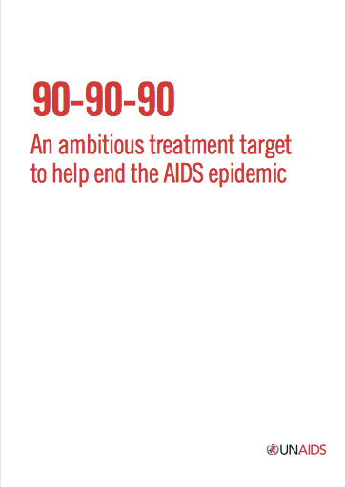
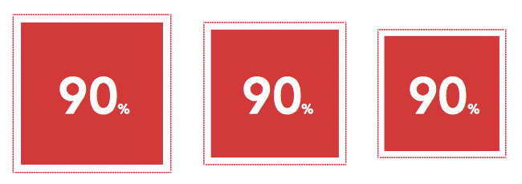
HIV - ‘test and treat’ - new global direction
Diagnosed
On
treatment
Virally
suppressed
http://www.unaids.org/en/media/unaids/contentassets/documents/unaidspublication/2014/90-90-90_en.pdf

Slide 15
UNAIDS 90-90-90:
HIV Treatment Targets for 2020 with Global Estimates (2013)
Access to care – are we meeting targets?
90% of HIV+ people diagnosed
90% of those diagnosed on ART
90% of those on ART with undetectable HIV RNA
The Joint United Nations Programme on HIV/AIDS. 90-90-90 An ambitious treatment target to help end the AIDS epidemic. 2014; JC2684
Notes:
http://www.unaids.org/sites/default/files/media_asset/JC2702_GARPR2015guidelines_en.pdf

Slide 16
Access to care – are we meeting targets?
Ref: On ART = March 2015. How Aids Changed Everything. Fact Sheet. UNAIDS 2015. MDG 6: 15 YEARS, 15 LESSONS OF HOPE FROM THE AIDS RESPONSE July 2015. * Average viral suppression% Intention to Treat LMIC rate from a Systematic Review by McMahon J. et al. Viral suppression after 12 months of antiretroviral therapy in low-and middle-income countries: a systematic review." Bulletin of the World Health Organization 91.5 (2013): 377-385.
Notes:
http://www.unaids.org/sites/default/files/media_asset/JC2702_GARPR2015guidelines_en.pdf

Slide 17
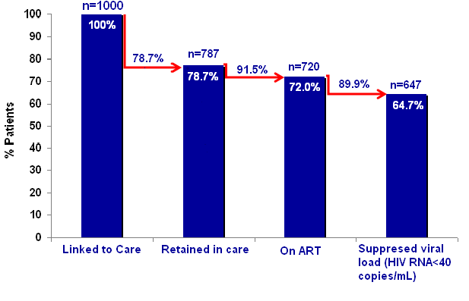
HIV care continuum – Mater Hospital¹
1. McGetterick et al. HIV Clinical Trials 2017

Slide 18
Antiretroviral therapy as prevention….
Does treatment of the HIV+ person prevent onward HIV transmission?
If ART prevents transmission are condoms still needed?
Can population treatment with ART control the HIV epidemic?
Can treatment of the HIV NEGATIVE person prevent infection?

Slide 19


Study Design
www.ipergay.fr
Randomized Double-Blinded vs. Placebo then Open-Label Extension
Feb 2012
Nov 2014
Jun 2016
TDF/FTC
On Demand
HIV-negative MSM
Condomless anal sex with > 2 partners in prior 6 months
Creat. Clearance > 60 mL/mn
HbS Ag negative
TDF/FTC
On Demand
Placebo
On Demand
Condoms, gels, tests for HIV (using 4th generation assays) and STIs, vaccinations for Hepatitis A and B, and peer counseling on risk reduction and adherence
Follow-up every two months
Notes:
19

Slide 20


IPERGAY : Sex-Driven iPrEP
2 tablets 2-24 hours before sex
1 tablet 24 hours later
1 tablet 48 hours after first intake
Friday
Tuesday
Wednesday
Saturday
Sunday
Monday
Thursday
Friday
Saturday
Sunday
4 pills of TDF/FTC taken over 3 days to cover one sexual intercourse

Slide 21
KM Estimates of Time to
HIV-1 Infection (mITT Population)
0.20
0.18
Log-rank test p=0.0022
0.16
0.14
0.12
Placebo
0.10
Probability of HIV Infection
0.08
0.06
TDF/FTC
0.04
0.02
0.00
0
2
4
6
8
10
12
14
16
18
20
22
24
months from D0
N at risk :
Placebo
201
142
74
55
42
TDF/FTC
199
141
82
58
43
Median follow-up of 9.3 months: 16 subjects infected
14 in placebo arm (incidence: 6.60 /100 PY) and 2 in TDF/FTC arm (0.91 /100PY)
86% relative reduction in the incidence of HIV-1 (95% CI : 40-98, p=0.002)
NNT to avert one HIV-infection: 18 (95% CI: 11-50)
Molina et al NEJM 2015
Notes:
Figure 2. Kaplan–Meier Estimates of Time to HIV Infection (Modified Intention-to-Treat Population). The cumulative probability of HIV acquisition is shown for the two study groups. The efficacy of preexposure prophylaxis with emtricitabine and tenofovir disoproxil fumarate (FTC–TDF) was 44%, as compared with placebo (P=0.005). The inset graph shows a more detailed version of the overall graph up to a probability of 0.10.

Slide 22
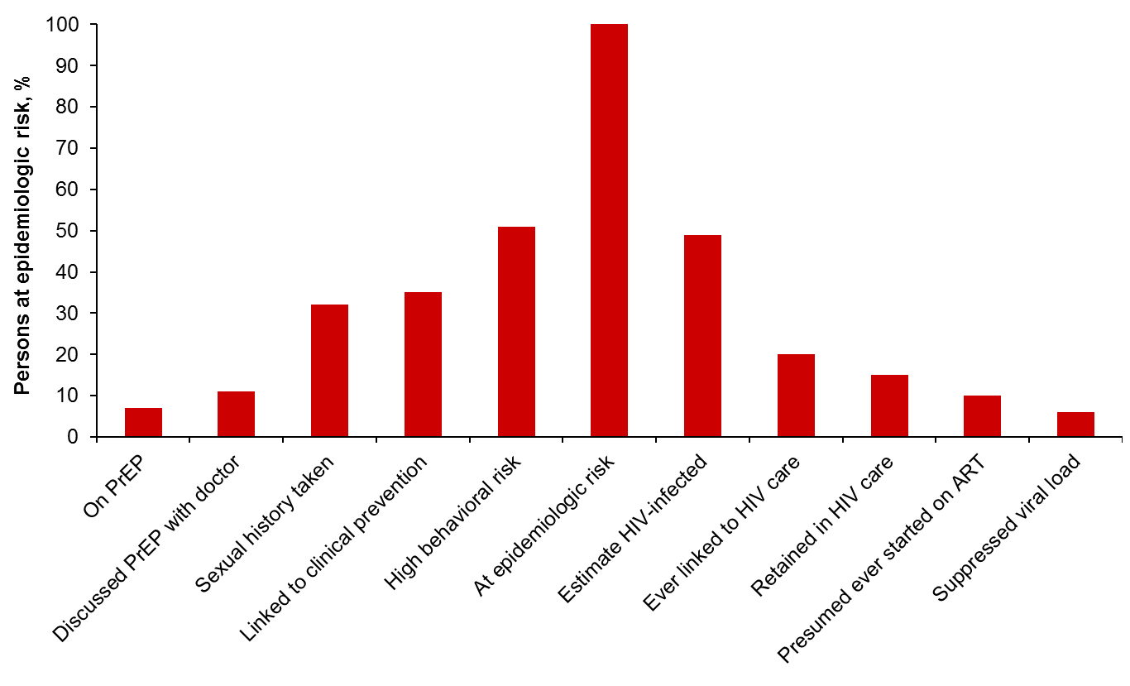
Going beyond undetectable…..
A Model for an “HIV Neutral” Continuum of Care
Prevention
Infection
Undiagnosed
Diagnosed
HIV care and prevention are the same = getting to HIV neutral
Notes:
Transition:
Here is a theoretical continuum of HIV-related care for prevention and treatment.
Main message:
T

Slide 23
Going beyond undetectable…..
Developing prevention services…moving into the community
POPULATION TESTING
& RISK ASSESSMENT
INDIVIDUAL INTERVENTION
ENGAGEMENT INTERFACE
- HIV SCREENING
POPULATION AT RISK
HIGH RISK
HIGHEST RISK
PrEP
DRUG
COUNSELLING, MONITORING
EDUCATION, STI SCREENING, CONDOMS

Slide 24
HMRG Involvement in preventative research
M-BRiHT- The Mater-Bronx Rapid HIV Testing Project
Explored the acceptability and feasibility of implementing unselected rapid HIV screening with a novel computer-based video counseling program in hospital Emergency Departments
PrEP Research
DISCOVER clinical trial-is a randomized, double-blind study comparing the use of two different combinations of anti-HIV drugs to prevent sexually acquired HIV infection.
Proposing a community-based versus Hospital-based delivery of PrEP Service; a randomised prospective

Slide 25
Questions?

